Slide 1
RETAIL ANALYTICS
Customer Shopping Behavior
What 3,900 orders reveal about revenue, customers, and growth gaps
ORDERS
REVENUE
AVERAGE RATING
3,900
$233K
3.75 / 5

Slide 2
EXECUTIVE READOUT
3,900 orders reveal a $233K retail business
AVERAGE ORDER VALUE
AVERAGE REVIEW RATING
ANALYSIS STACK
$59.76
3.75
Python · SQL Server · Power BI
out of 5
A compact order-level view of revenue, customers, products, promotions, and satisfaction.

Slide 3
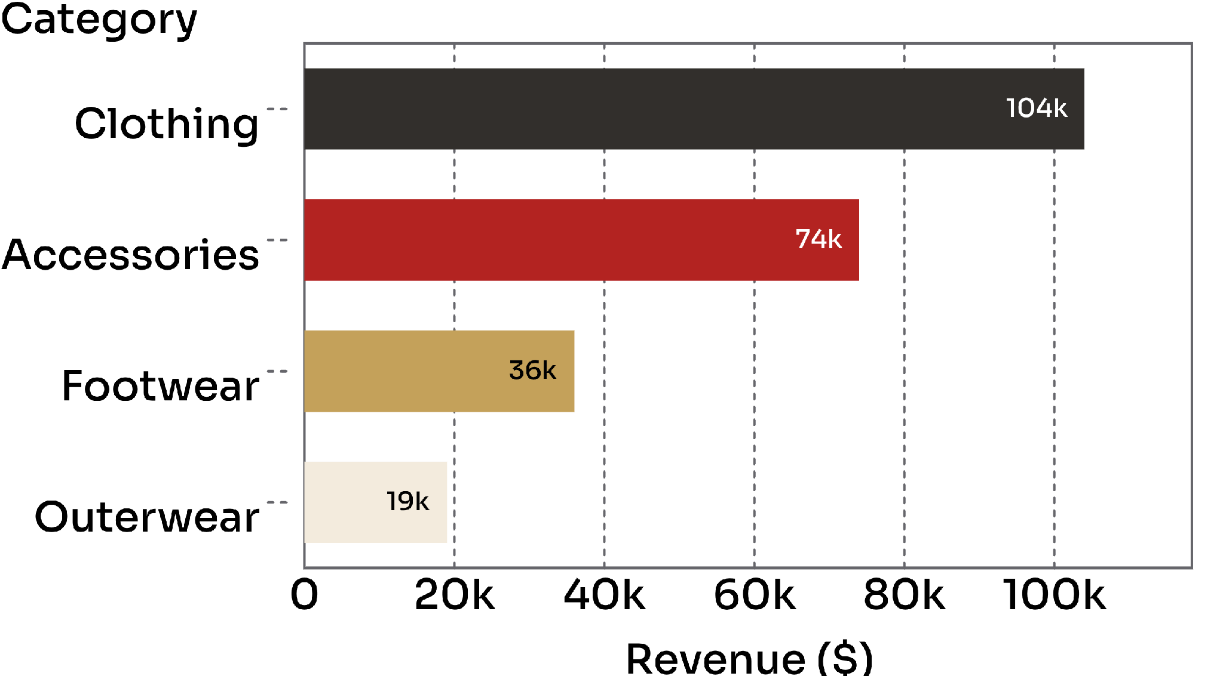
REVENUE MIX · CATEGORY
Clothing and Accessories carry 77% of revenue
77%
of revenue comes from two categories.
Clothing: $104K, about 45% of revenue
Accessories: $74K, about 32%
Footwear and Outerwear contribute about 23% combined

Slide 4
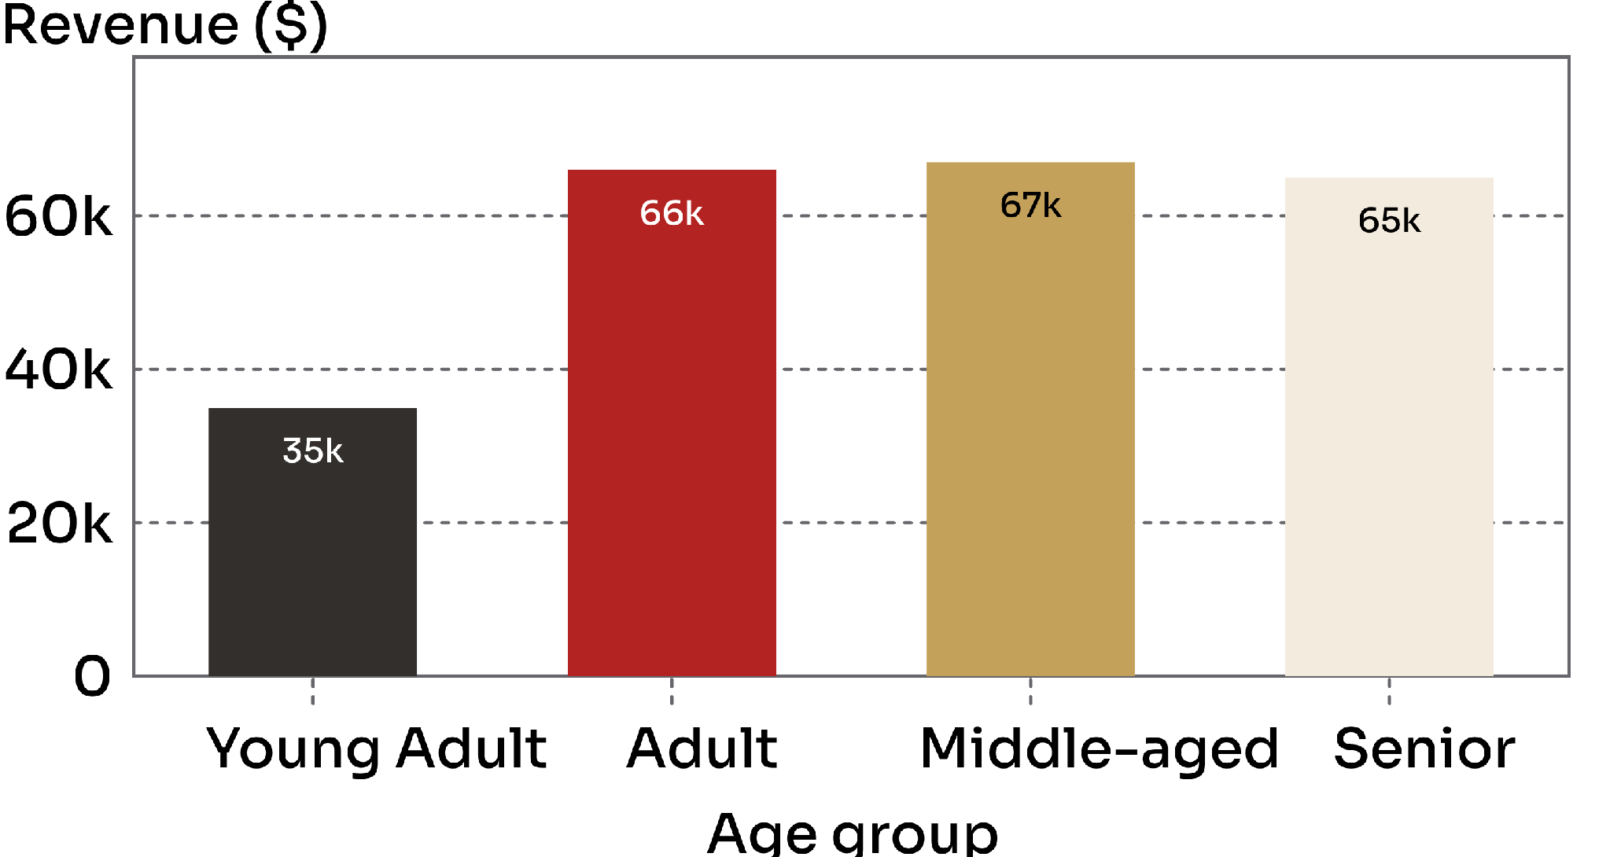
REVENUE MIX · AGE GROUP
Young Adults are the clearest growth gap
15%
of revenue comes from Young Adults.
Young Adults contribute about $35K
Adult, Middle-aged, and Senior groups each contribute about $65K–$67K
571 Young Adult customers versus roughly 1,100 in each other group

Slide 5
SUBSCRIPTION CHECK
Subscription is not lifting basket size
Average order values are effectively flat between subscribers and non-subscribers.
SUBSCRIBED CUSTOMERS
NON-SUBSCRIBERS
$59.49
$59.87
average per order
average per order
27%
Subscription participation exists, but the current benefit structure is not increasing basket size.
of revenue from subscribers

Slide 6
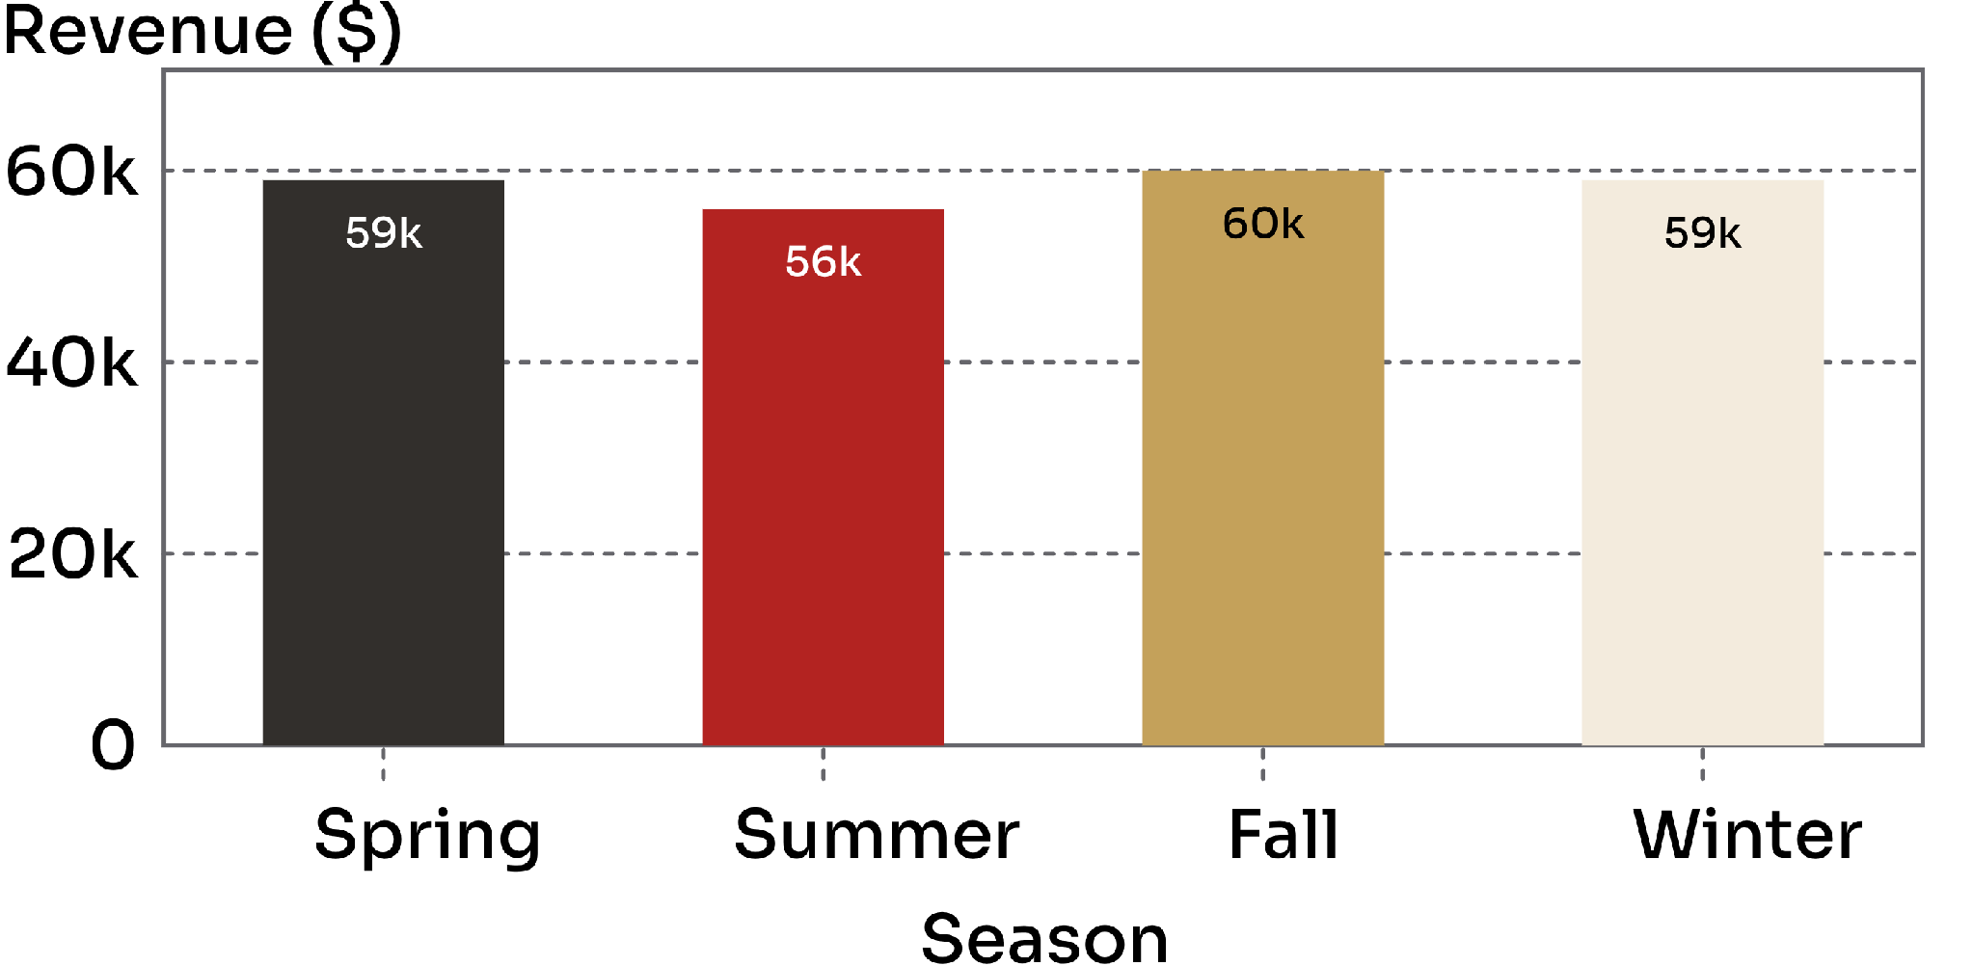
REVENUE STABILITY · SEASONAL AND REGIONAL
The business is steady across seasons and states
$56K–$60K
seasonal revenue range
Top states range narrowly from about $5.2K to $5.8K
No clear seasonal or regional campaign winner emerges

Slide 7
PROMOTION AND SATISFACTION
Discounts are common, while ratings remain middling
DISCOUNT OR PROMO USE
AVERAGE REVIEW RATING
1,677
3.75 / 5
of 3,900 orders · about 43%
customer feedback remains middling
Before expanding promotions
Compare discounted and full-price order values.

Slide 8
ACTION FRAMEWORK
Recommendations: focus where the evidence is strongest
01
02
Protect the core
Test Young Adults
Protect Clothing and Accessories with stock depth, bundles, and focused promotions.
Build a targeted growth test for 18–25-year-olds.
03
04
Rework subscription
Keep campaigns national
Rework subscription benefits to raise basket size or purchase frequency.
Keep national campaigns as the default until stronger regional or seasonal signals appear.

Slide 9
READING THE EVIDENCE
What the analysis can and cannot answer
CAN SHOW
CANNOT SHOW
Where revenue is concentrated
How behavior changes over time
Category mix, age-group revenue, subscription share, promotion use, ratings, seasons, and states.
The data has no dates, so it cannot show trends over time or repeat-purchase behavior.
Young Adult context
State context
Use the findings carefully
Young Adult revenue is partly affected by the group’s smaller customer count.
State differences may be noise because revenue per state is only about $5K–$6K.
The strongest signals are category concentration and the Young Adult gap.

